Slide 1
Hangman: The Game
CSPC 223J Final Project
By: Jon Limas

Slide 2
Program’s Objective:
Implementation of JFrame GUI
Further use of 2D-Arrays
Experimentation w/ General Program Design
Exercising Creativity and Critical Thinking Skills
To develop a fully-operational Hangman game that:
challenges the user’s vocabulary
promotes the idea that learning can be fun :)

Slide 3
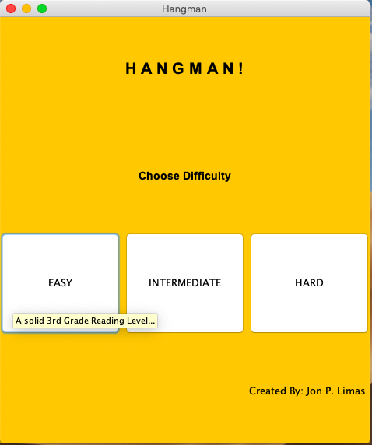
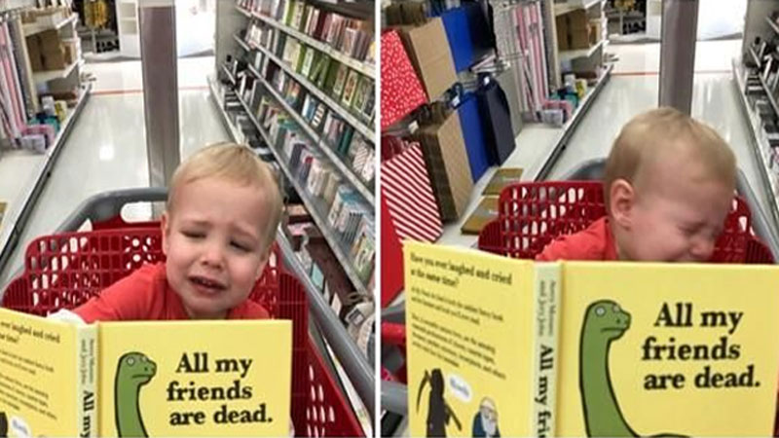
Home Page
EASY MODE
Source: https://knowyourmeme.com/memes/my-son-did-not-enjoy-this-book

Slide 4
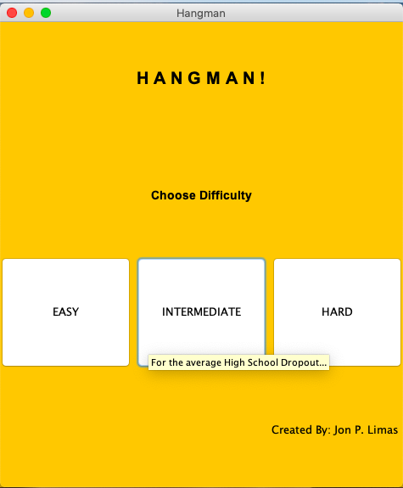
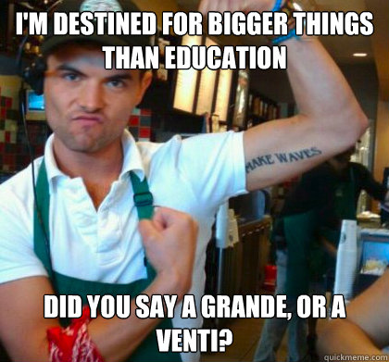
Home Page
INTERMEDIATE MODE
Source: http://www.quickmeme.com/Dilussional-High-School-Drop-Out

Slide 5
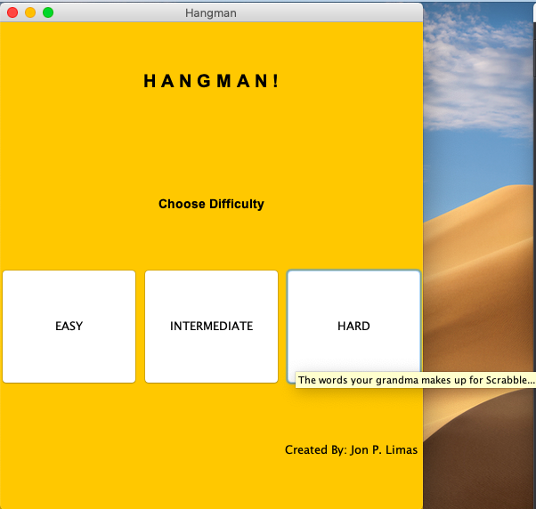
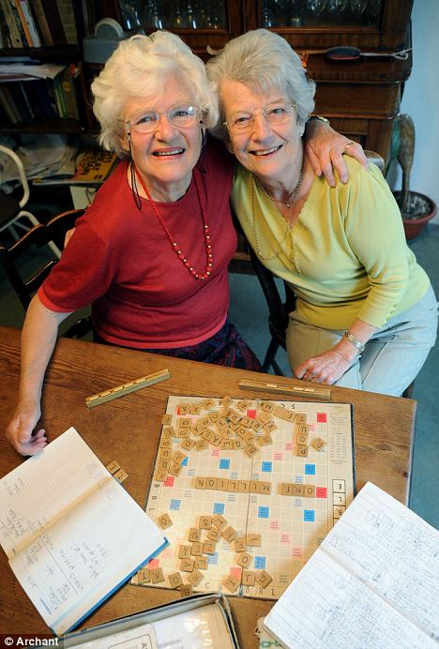
Home Page
HARD MODE
Source: https://www.dailymail.co.uk/news/article-2174656/Scrabble-fanatics-celebrate-topping-MILLION-points-keeping-score-tally-1965.html

Slide 6
How The Game Works:
User is given a random generated word
Word pulled out from a wordbank
Based on level of difficulty chosen
User has to guess word, letter by letter
If right, location(s) of letter is revealed on screen
If wrong, a body part of the Hangman is drawn on the screen
User loses if entire Hangman is drawn on the board
6 total body parts = 6 wrong guesses

Slide 7
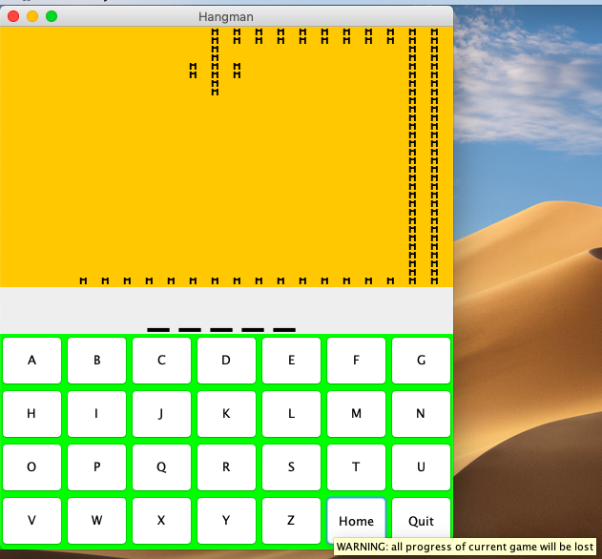
Game Page
Functionality
Home Button: Returns to home page.

Slide 8
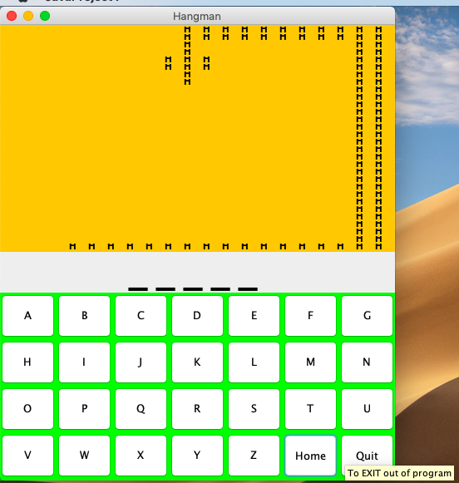
Game Page
Functionality
Quit Button: Terminates the program.

Slide 9
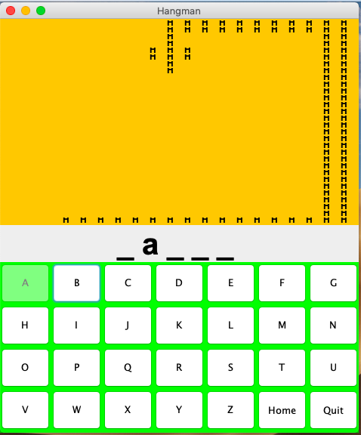
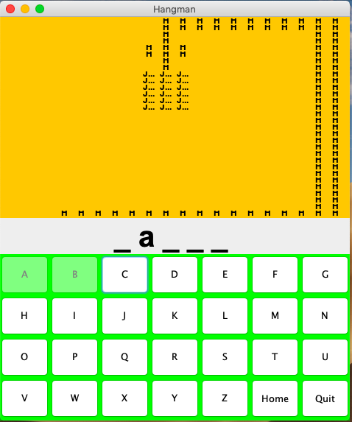
Correct guess
Incorrect guess

Slide 10
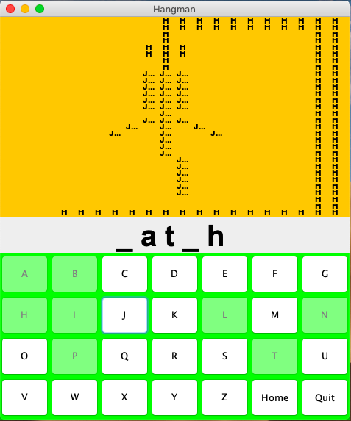
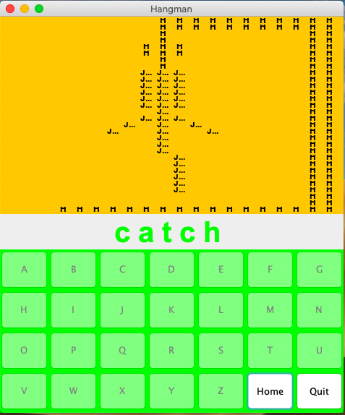
Correct guess: T
WINNER

Slide 11
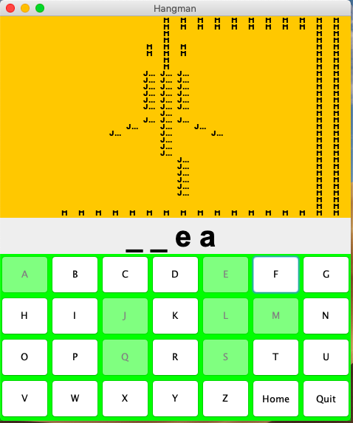
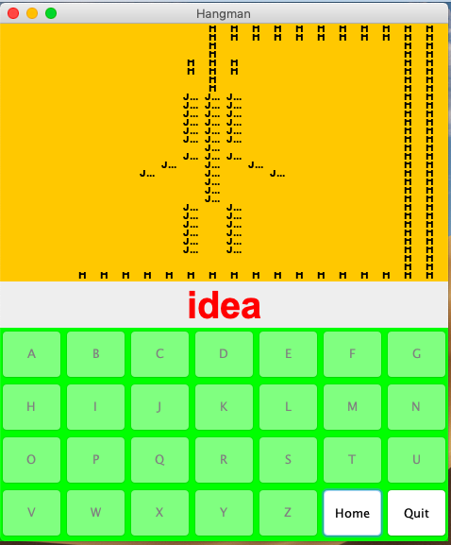
Incorrect Guess: T ->>>>>>>>>>>
LOSER

Slide 12
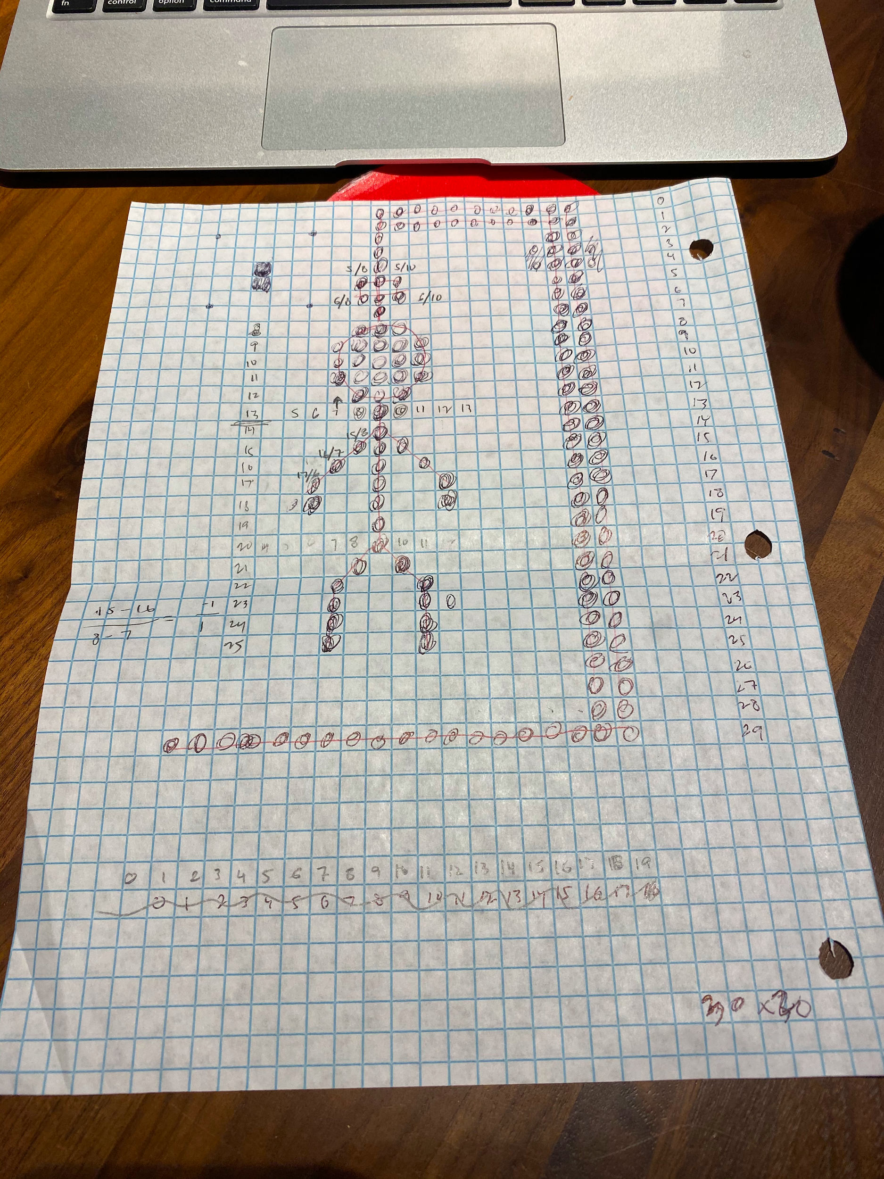
Drawing the Hangman:
**Rough Sketch of Hangman Grid

Slide 13
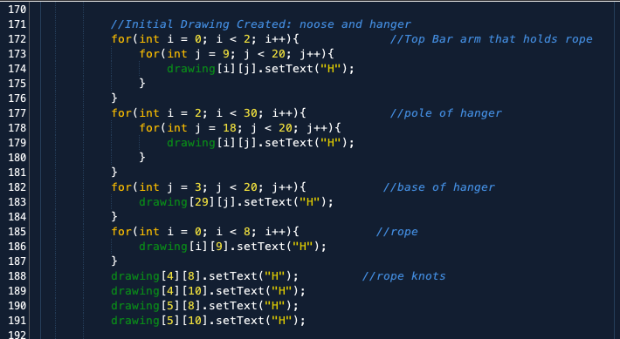
Drawing the Hangman:

Slide 14
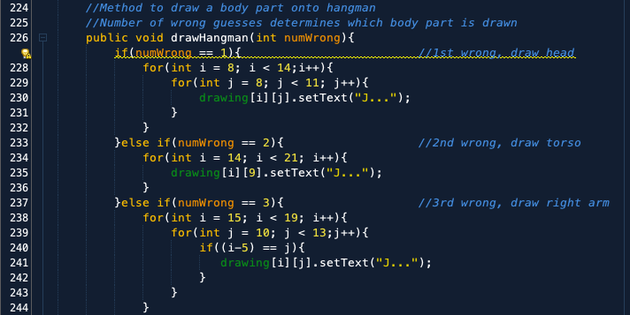
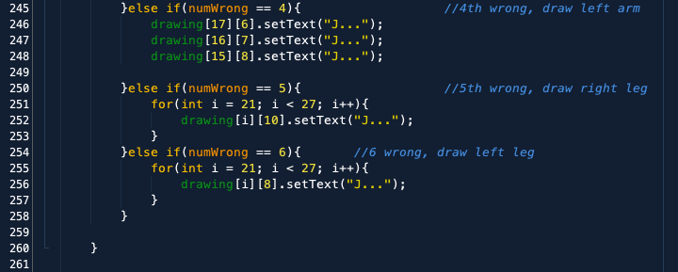

Slide 15
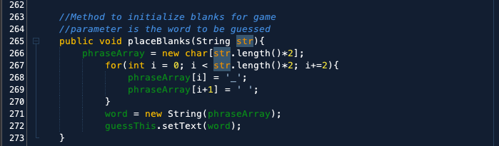
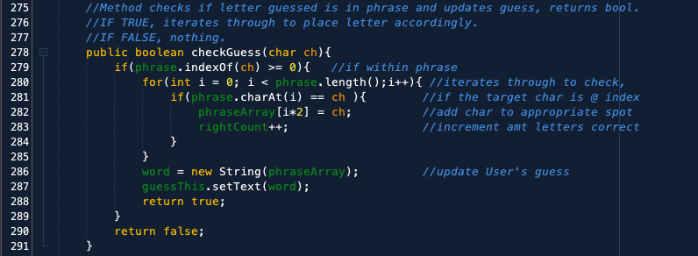
Key Functions/Methods:

Slide 16
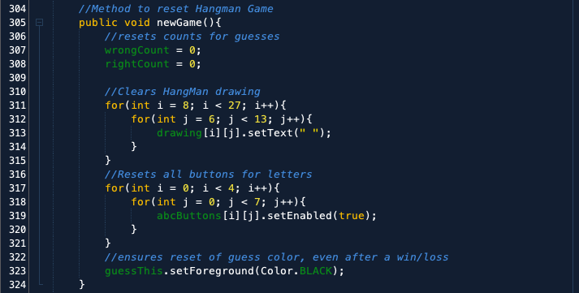

Slide 17
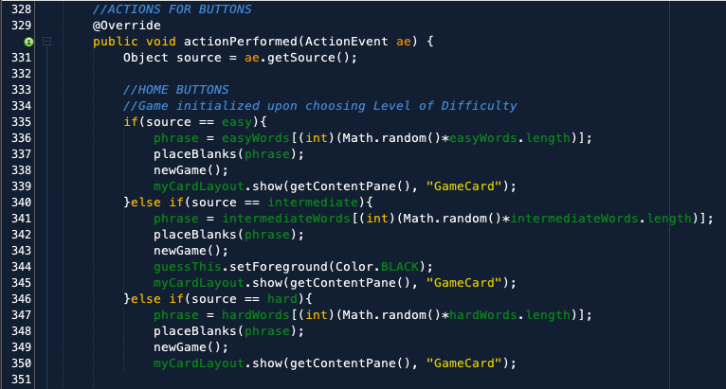
Action Perfomed Method: USER DIFFICULTY BUTTONS

Slide 18
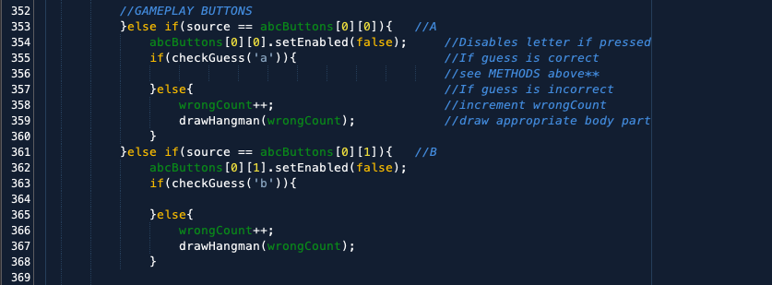

Action Perfomed Method: BUTTONS ‘A’- ‘Z’, “Home”, and “Quit”

Slide 19
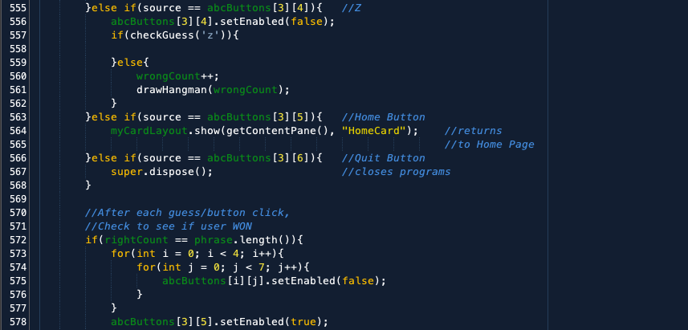
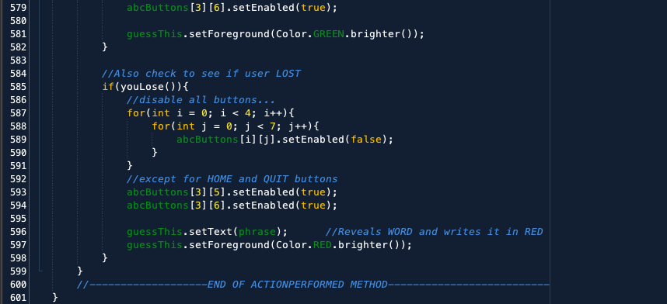
Action Perfomed Method: Checking for Win/Loss after every turn

Slide 20
Conclusion:
Overall Experience
Snippet of what it takes to be a programmer
Learning how to be more resourceful
Due patience, due diligence l
Very Satisfying
Lots of fun
Future Updates
Methods?
Word hint(s)?
Scorekeeping/Points System?
External wordbank source?

Slide 21
THE END
Thank You!

